Slide 1

(CUSTOMER) Presentation

Slide 2

Introduction
Flexpak is one of the largest and fastest growing packaging distributor in the Mountain West
Founded in 2002
Warehouse space over 475,000 square feet between multiple locations.
In-house design team with box assembly and molded foam conversion abilities
Dedicated delivery trucks supporting over 1,800 active customers in Utah alone
Proven track record of customer service and support
Kitting and Fulfillment capabilities
Certified ‘Made in Utah’ Company

Slide 3
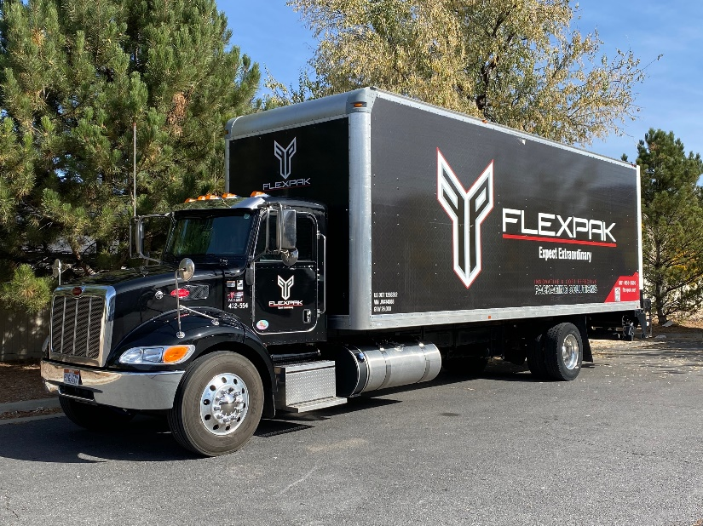
Mission Statement
Our Mission
The purpose of our business is supporting our customers with all their packaging needs. We go to great lengths to provide innovative and creative packaging solutions. Expect Extraordinary!
Products
Flexpak offers a complete array of packaging supplies and materials. From packing tape to corrugated boxes and FlexFoam, we offer all the products needed to complete any type of packaging task our customers could require.
Solutions
With years of product design, sourcing and importing, Flexpak offers our customers international expertise and resources to complete and exceed expectations with any and all packaging requirements.

Slide 4
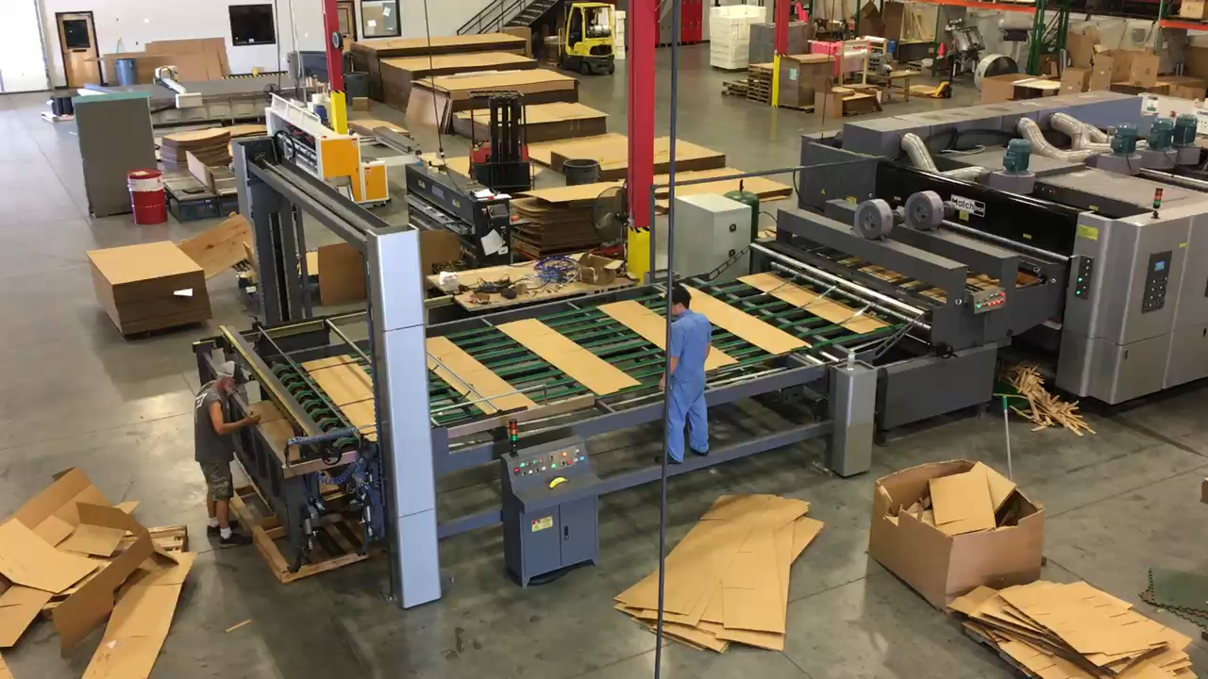
Product Lines & Capabilities
Corrugate – In house manufacturing of stock and custom boxes including custom printing, full litho, and direct print
Poly Film & Poly Bags – Stock and custom products in all configurations including ESD
Bubble and Foam Wrap – Full selection of ESD and standard rolls, pouches, and mailers
Tape – Everything from basic boxing tape to high spec custom products
Dimensional Foam – All types of dimensional foam products for nesting, shipping coolers, and custom void fill
FlexFoam Polyurethane Foam in Place – On-site design and production of custom foam / box packaging. In-house mold design and manufacturing
Poly Steel and Banding – A full selection of sizes and accessories for Poly and Steel banding needs
RanPak Packaging Systems – Kraft paper based void fill and cushion equipment that provides a recyclable and cost effective solution.
Machinery – All types of machines from Tape application to stretch wrap, air pillows, and heat shrink equipment. All backed with an on-staff certified technician.
In-House Designer – For any and all graphics requirements and packaging design
International Sourcing and Importation – Monthly containers from the Pacific Rim

Slide 5
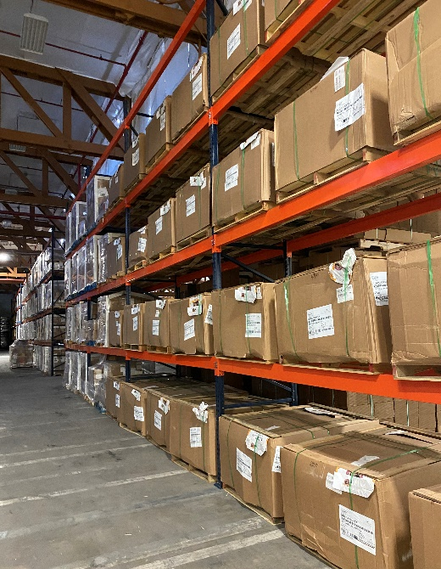
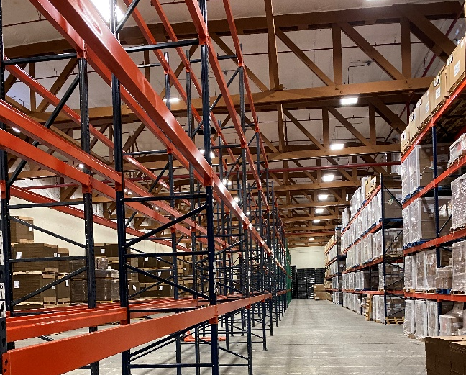
Warehousing
Flexpak operates 135,000 sq feet of warehouse in the Ogden BDO
Provide deliveries on a daily basis if needed
Emergency contacts available 24/7

Slide 6

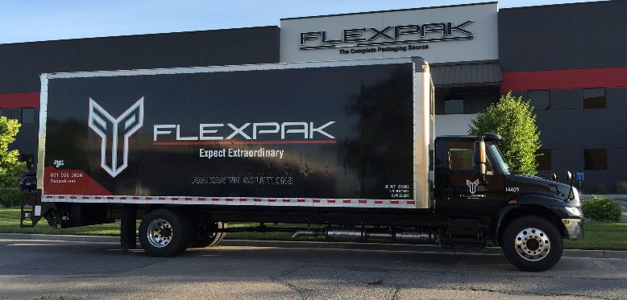
Summary
Flexpak is the West’s largest and fastest growing packaging company. We have the capability of supplying complete packaging needs from tape to corrugate to stretch film and void fill. We are a complete packaging resource and can even complete fulfillment needs. We currently assemble product kits for several of our customers using items from domestic and off-shore sources. We have an in-house designer to complete even the most complex full litho packaging designs. Our company philosophy is simple: “We will never lose a customer based on service”
We are certified ‘Made in Utah’ and buy Utah wherever possible. We are excited to support local companies and their expansion and growth. We use corrugate suppliers that are part of the Sustainable Forest Initiative (SFI) which promotes renewable resources and recycling of corrugate products.
We look forward to a partnership with your company and invite you to visit our facility and meet our outstanding team.

Slide 7
Doug Bardsley
Business Development Manager
(435) 669-5240

